Slide 1
Accelerated Stochastic Progressive Photon Mapper on the GPU
Ishaan Singh, Yingting Xiao, Xiaoyan Zhu

Slide 2
Photon Mapping
Rendering technique based on irradiance caching and bidirectional pathtracing
Speeds up global illumination computation by caching photons
Combines direct illumination from raytracing with a final gather step to account for GI.
Less noisy than pathtracing

Slide 3
Photon Mapping
Needs to store a lot of photons for compute GI.
This problem is solved by using a progressive photon map
A smaller number of photons are generated per iteration
Irradiance averaged across iterations

Slide 4
Photon Creation
Emit photons from all lights in the scene
Bigger lights and lights with more emittance generate more photons
Bounce photons around the scene and intersect with objects in the scene
Photons are stored when it hits a diffuse surface
Photons are bounced when it hits a reflective or refractive surface
Use stream compaction to remove “dead” photons that shoot into the void

Slide 5
Spatial Hash Grid
For the final gather step, we need to do a K nearest neighbor search
Brute force search is simple but prohibitively expensive
Instead, we use a spatial hash grid
Each photon is assigned a grid index based on its xyz world position
Sort the photons by hash value
Each hash grid cell stores only the start and end index of the photons that it contains
O(1) look up time for photons when a ray intersects a grid cell

Slide 6
Stackless Kd-Tree with Ropes
Used to speed up intersection tests with objects in the scene.
On the CPU, the scene is divided up into a kd-tree using surface area heuristics
Ropes are created to connect each kd tree node with its 6 neighbors (based on its 6 faces)
Linearize CPU tree data and transfer it to the GPU using a DFS
Each node stores indices pointing to its children and neighbors
Traverse the tree using ropes
March ray through the first node it intersects and test for intersection with primitives
If intersection found, it is the closest
Else, recurse on its neighbor

Slide 7
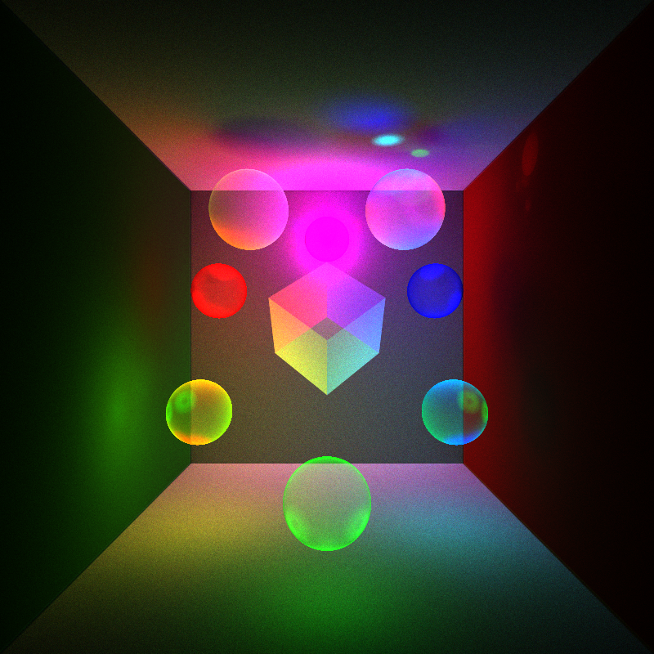
500 Million Photons

Slide 8

Depth test using the kd-tree on the CPU (about 2 seconds to render)

Slide 9
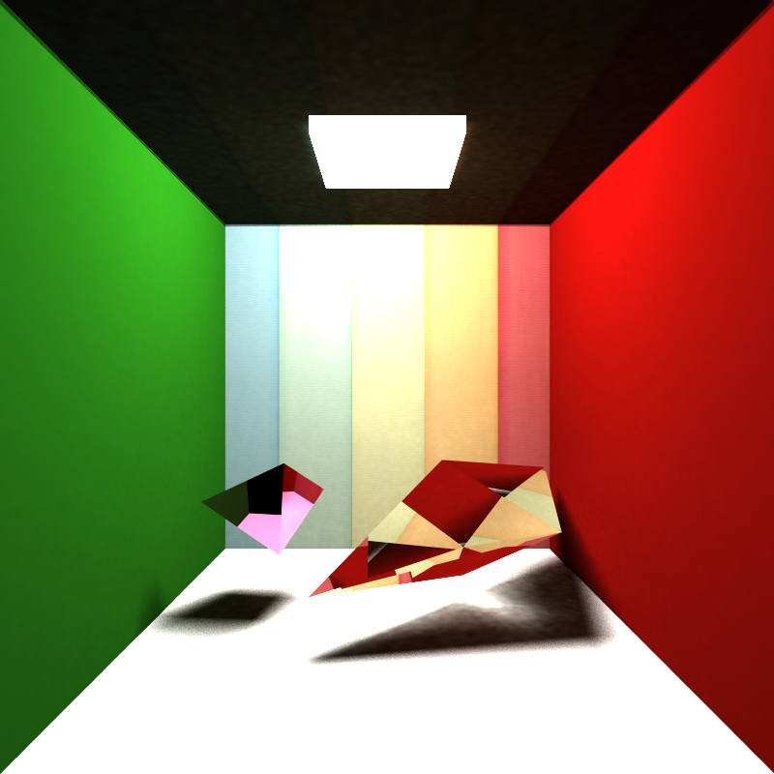
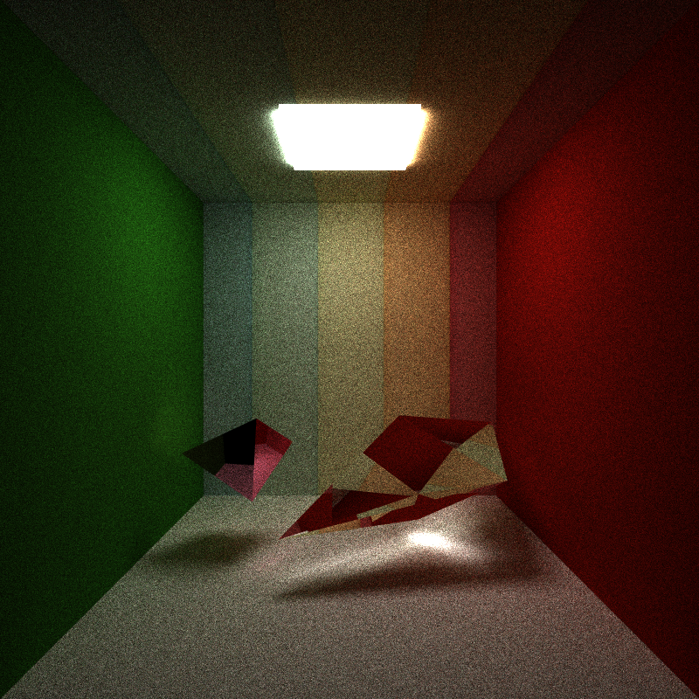
Photon mapping vs pathtracing, both at 500 iterations

Slide 10
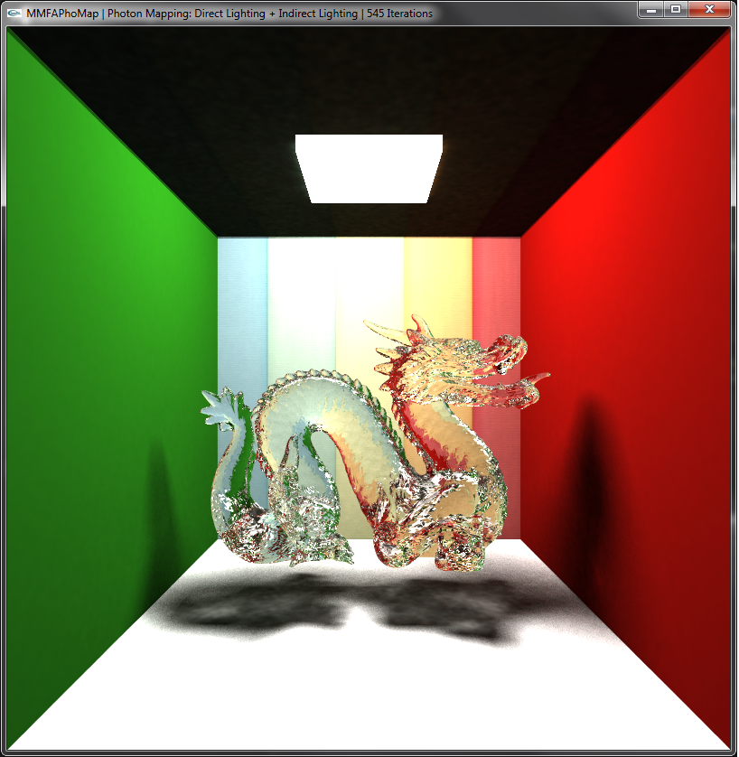
Refractive Stanford dragon, about 1 second per iteration on a GTX 480

Slide 11
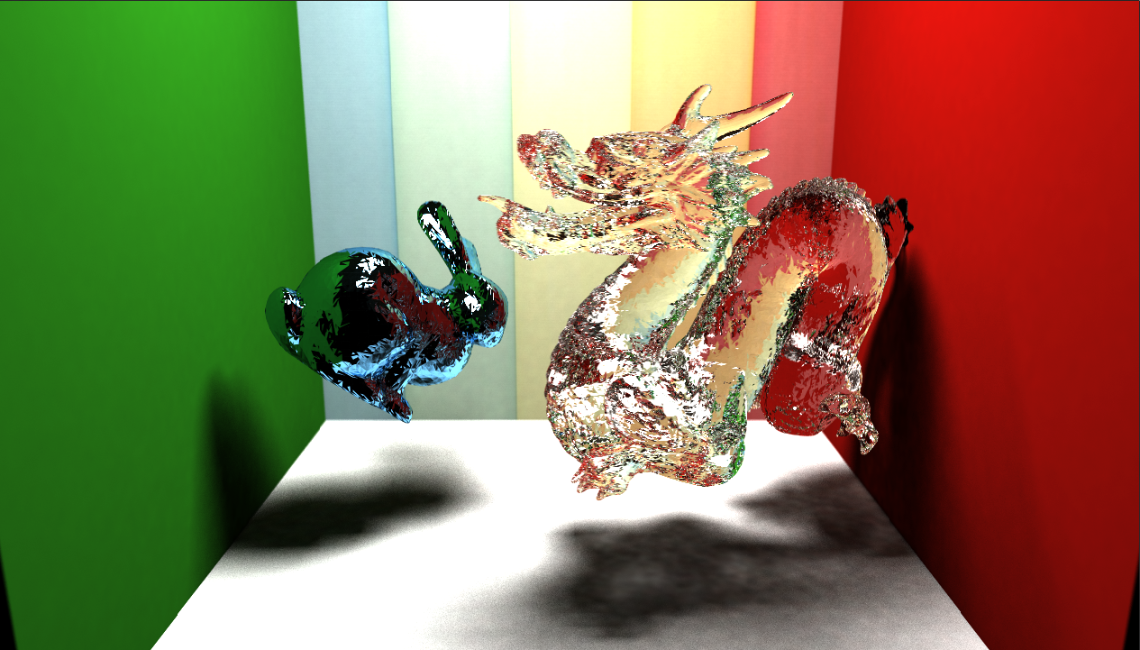
Reflective Stanford bunny and refractive Stanford dragon

Slide 12
Video
https://vimeo.com/81835028

Slide 13
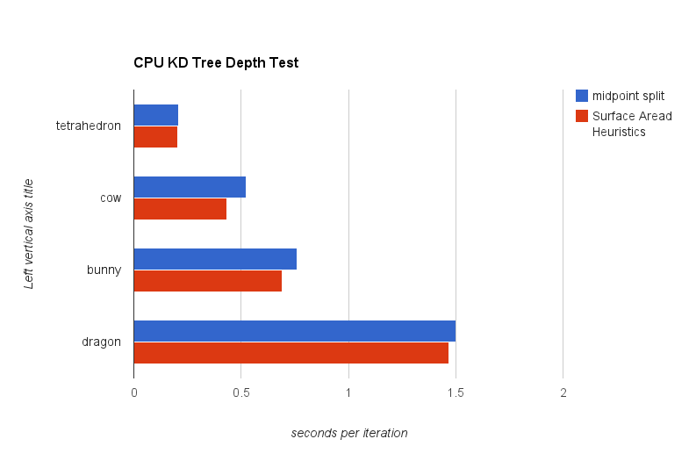
SAH vs Midpoint Split Kd-tree

Slide 14
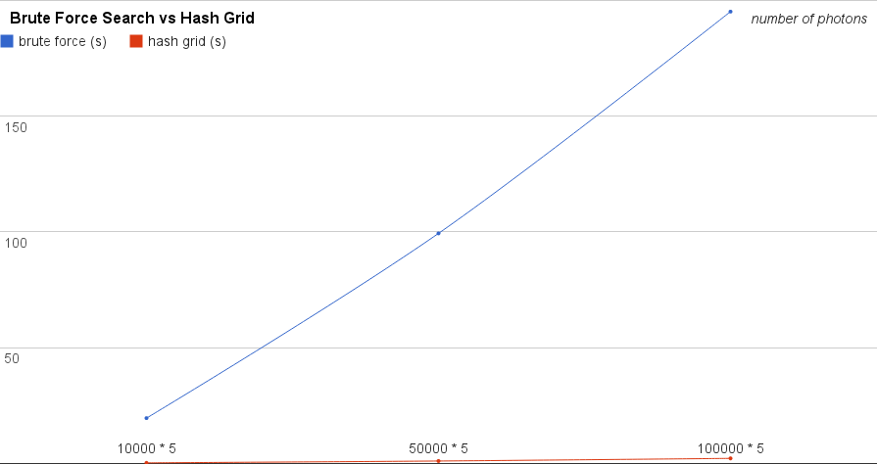
Brute Force Search vs Hash Grid Search

Slide 15
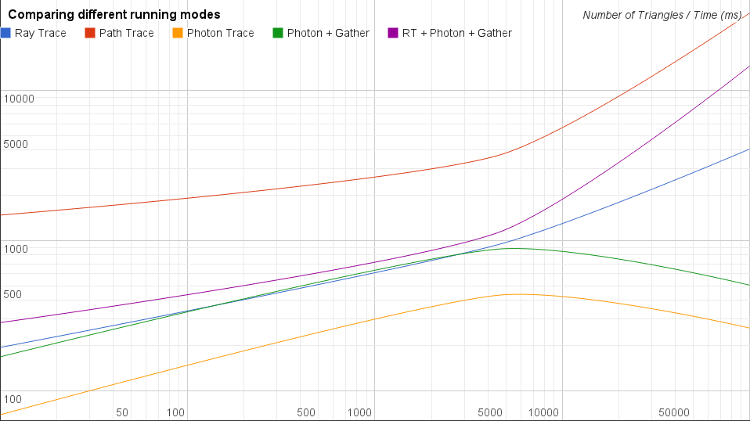
Comparison of Different Rendering Modes

Slide 16
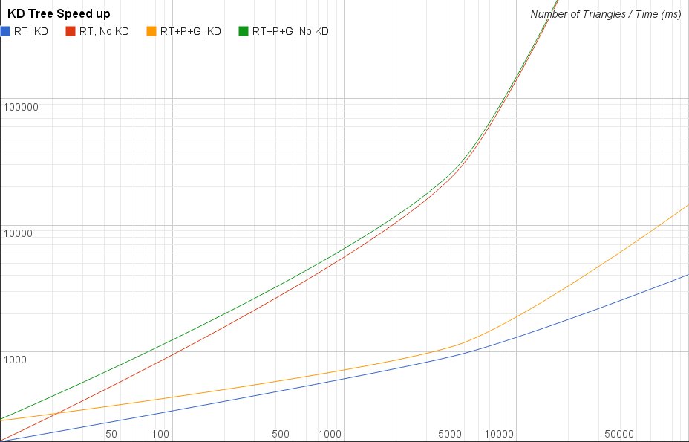
Speed Up with Kd-Tree

